Slide 1
Web Technology Unit 4 Server Side Scripting:PHP By Dr Prasanna B T SJCE,JSSSTU,Mysuru

Slide 2
Client Script :
Script downloaded and Executes on the client browser
The clients never get to see the code, just the HTML output from the script
Client cannot access web server resources

Slide 3
Server script:
In a server-side script, it is executed on the web server
The server sends the JavaScript (that the user could look at), but you have no guarantee that the script will even execute

Slide 4
In contrast, server-side source code remains hidden from the client as it is processed on the server
Server scripts cannot manipulate the HTML or DOM of a page in the client browser as is possible with client scripts
a server script can access resources on the web server whereas the client cannot

Slide 5
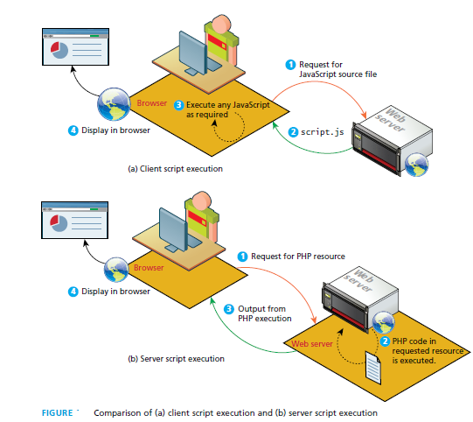

Slide 6
A server-side script can access any resources made available to it by the server.
These resources can be categorized as data storage resources, web services, and software applications

Slide 7
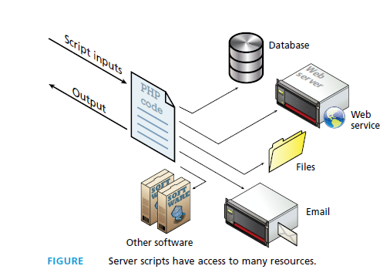

Slide 8
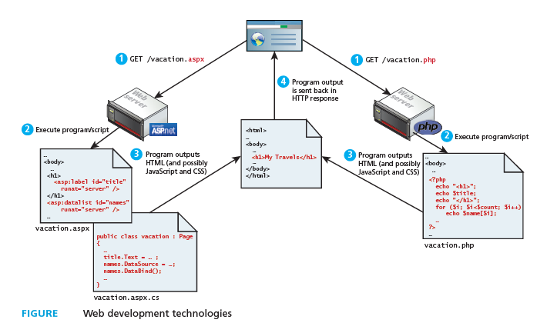

Slide 9
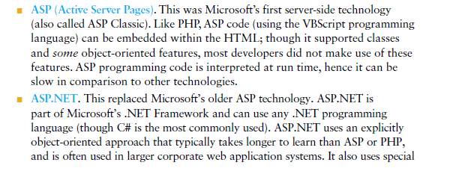
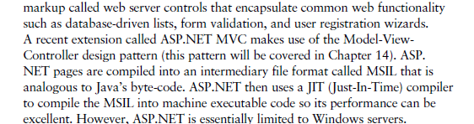

Slide 10
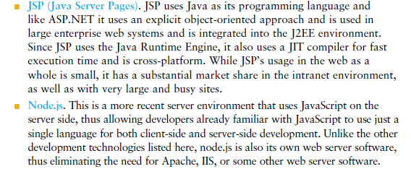

Slide 11
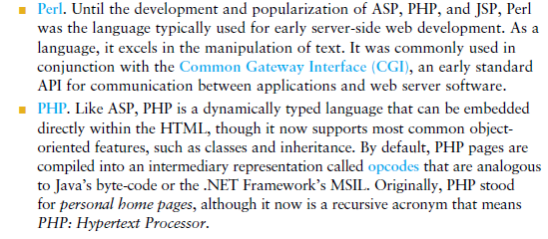

Slide 12
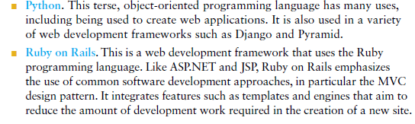
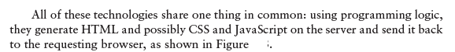

Slide 13
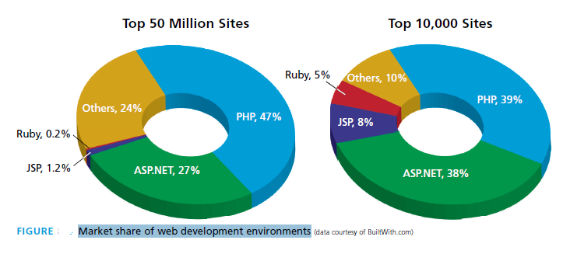

Slide 14
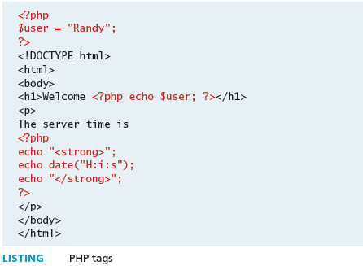

Slide 15
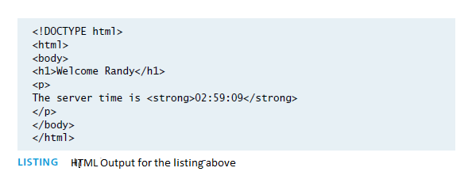

Slide 16
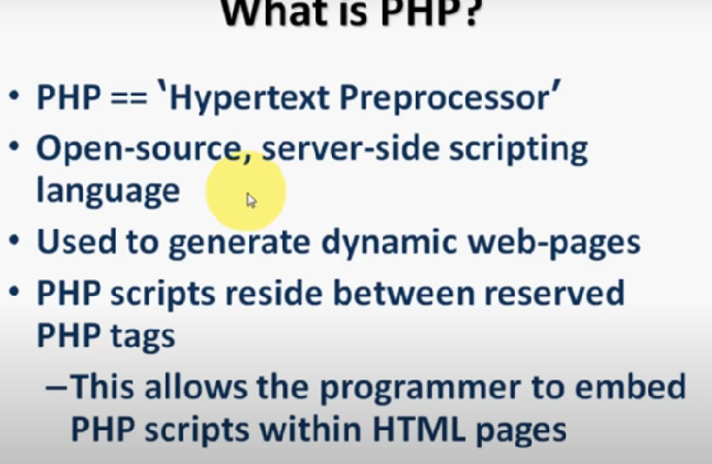

Slide 17
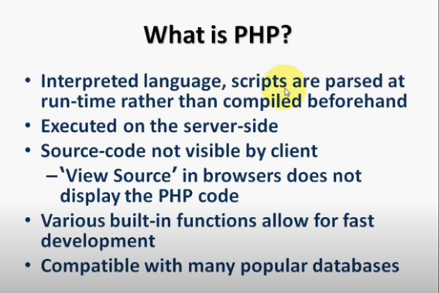

Slide 18
Goto php.net for detailed information about php

Slide 19
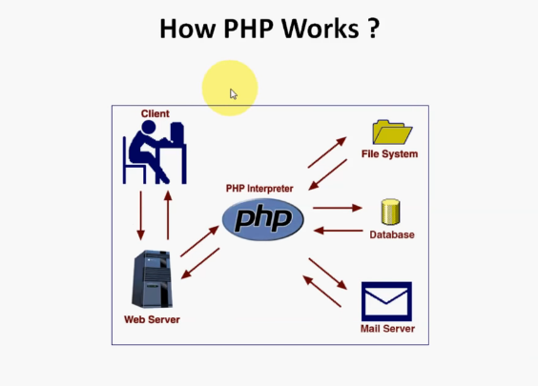

Slide 20
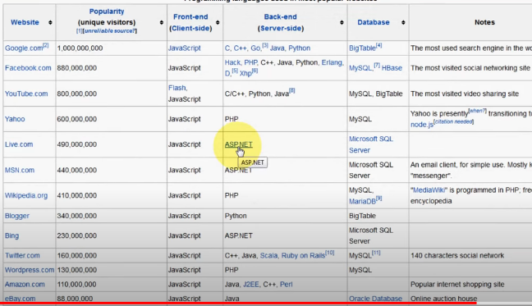

Slide 21
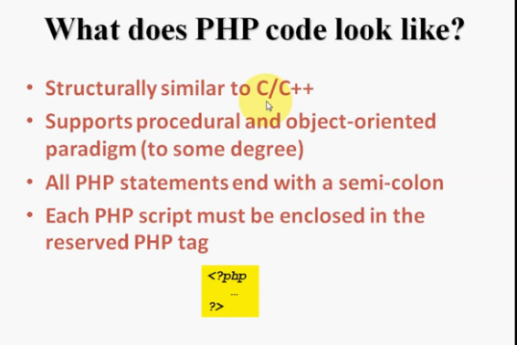

Slide 22
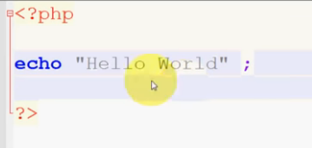

Slide 23
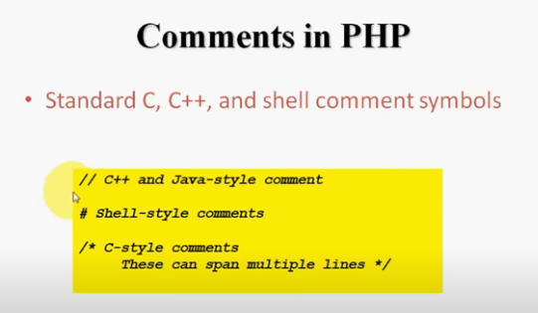

Slide 24
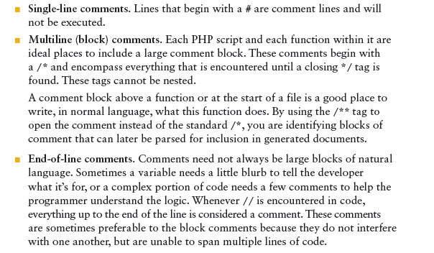
comments

Slide 25
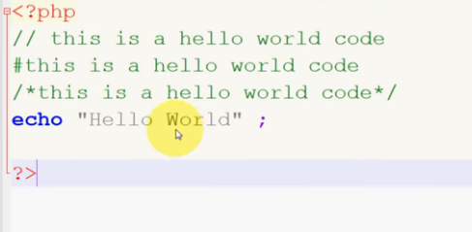

Slide 26
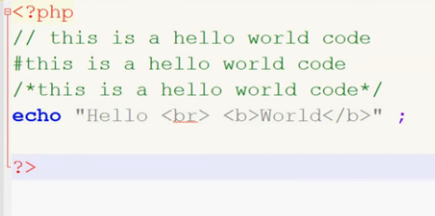
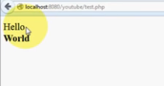

Slide 27
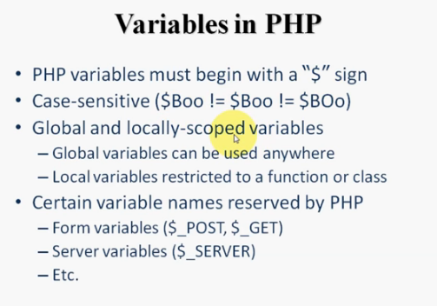

Slide 28
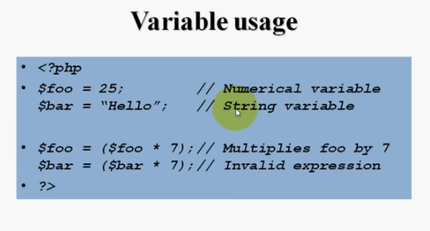

Slide 29
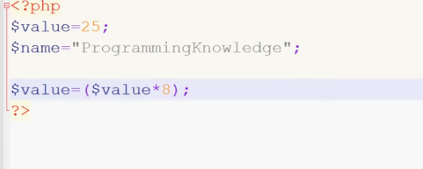

Slide 30
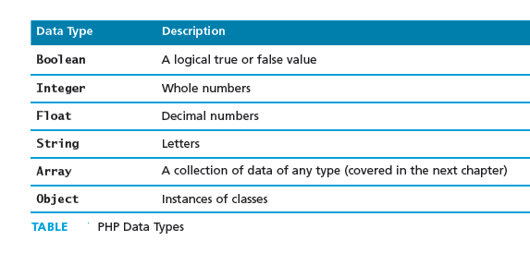

Slide 31
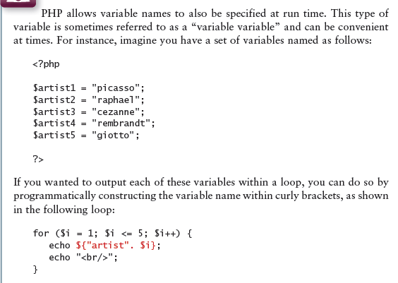

Slide 32
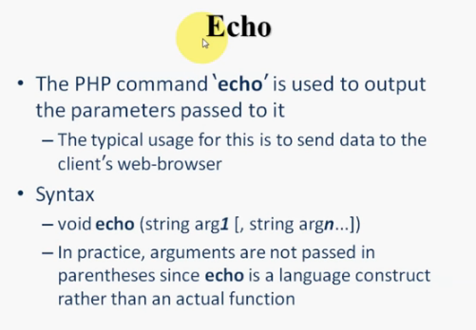

Slide 33
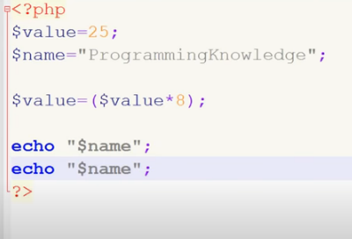

Slide 34
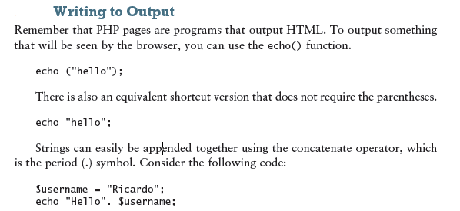

Slide 35
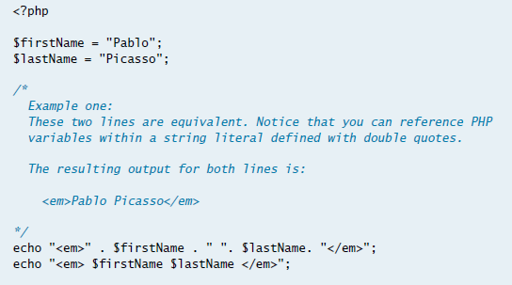

Slide 36
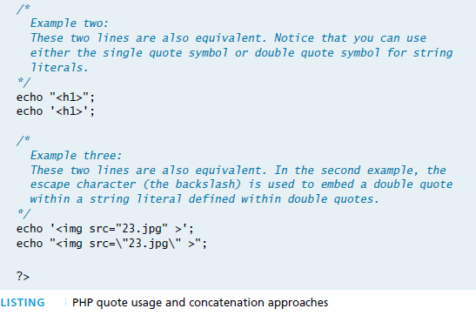

Slide 37
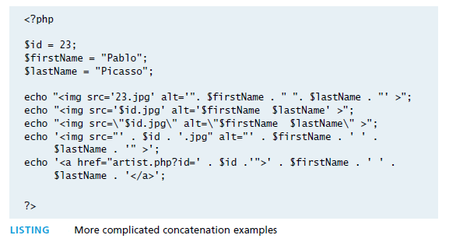

Slide 38
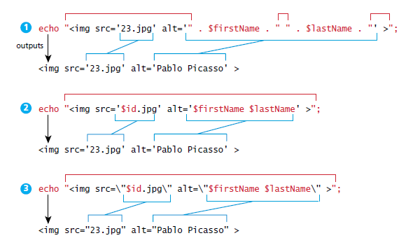

Slide 39
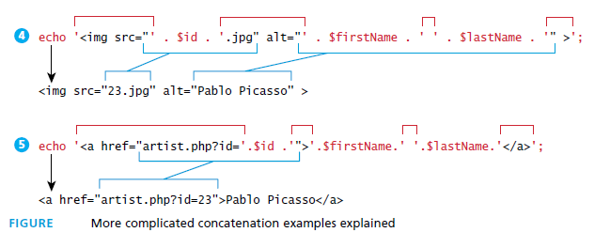

Slide 40
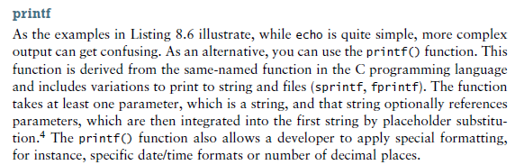

Slide 41
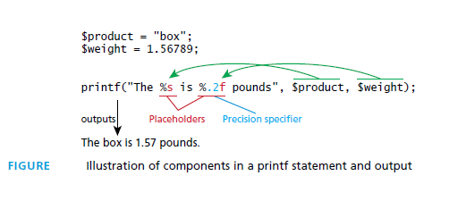

Slide 42
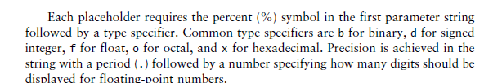

Slide 43
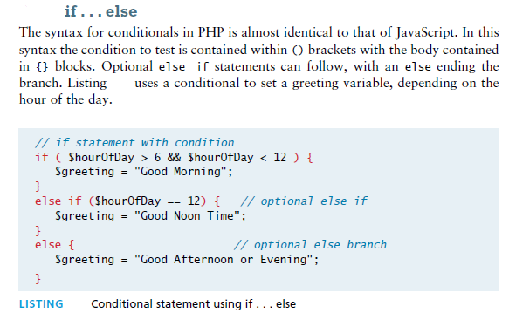
Program controls

Slide 44
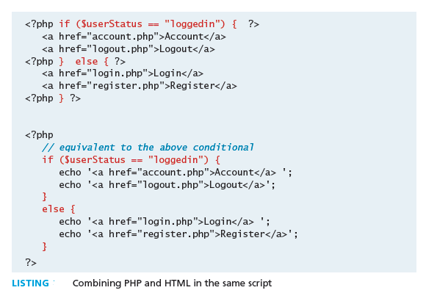

Slide 45
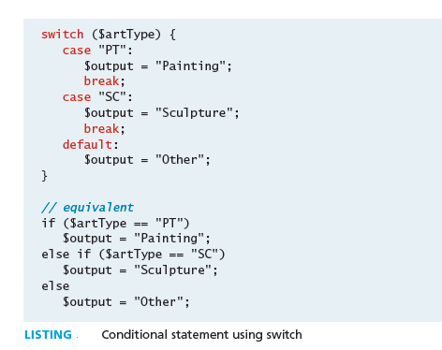
Switch

Slide 46
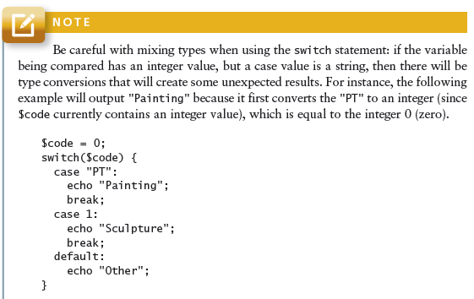

Slide 47
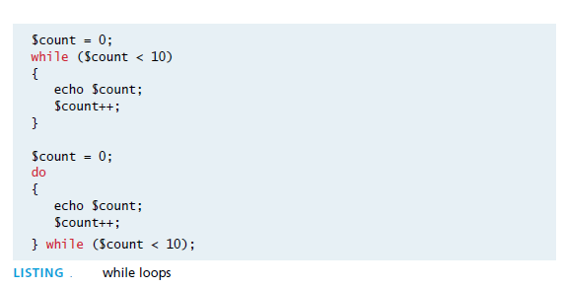
While do while

Slide 48
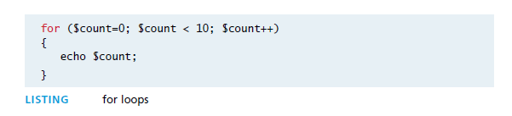
for

Slide 49
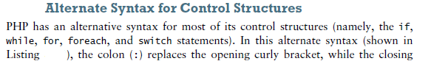
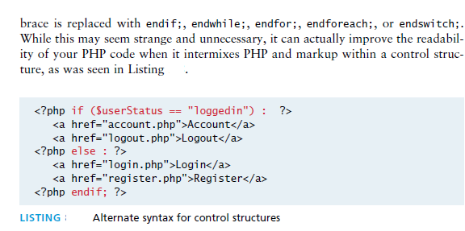

Slide 50
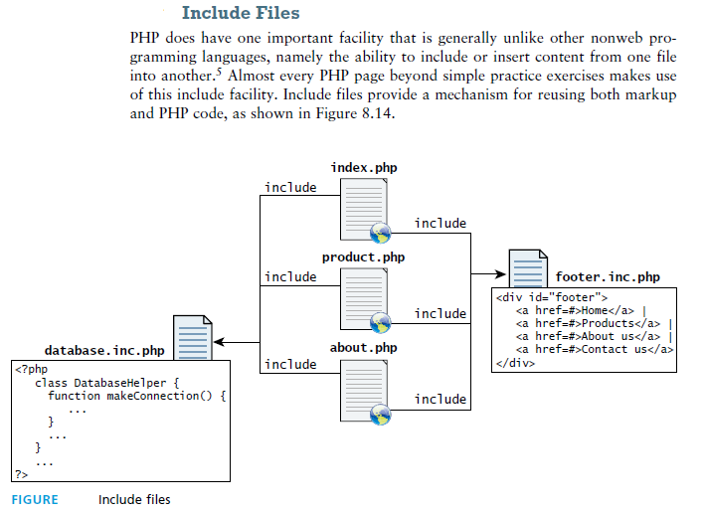

Slide 51
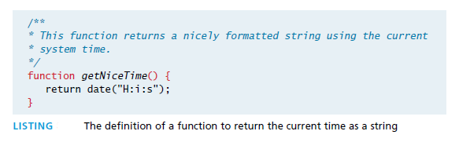
function

Slide 52
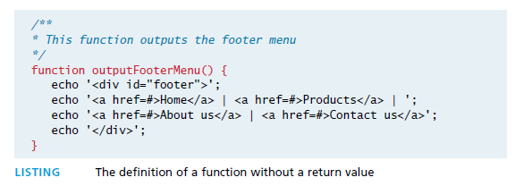

Slide 53


Slide 54

parameters

Slide 55


Slide 56


Slide 57


Parameter default values

Slide 58



Slide 59


Slide 60


Variable scope within functions

Slide 61


Slide 62

Arrays

Slide 63


Slide 64


Slide 65


Slide 66


Slide 67


Slide 68


Slide 69


Slide 70


Slide 71


Slide 72



Slide 73


Slide 74


Slide 75



Slide 76



Slide 77


Slide 78


Slide 79


Slide 80


Slide 81


Slide 82


Slide 83



Slide 84


Slide 85


Slide 86


Slide 87



Slide 88


Slide 89


Slide 90


Slide 91


Slide 92


Slide 93


Slide 94


Slide 95


Slide 96


Slide 97


Slide 98


Slide 99


Slide 100



Slide 101


Slide 102


Slide 103


Slide 104


Slide 105



Slide 106


Slide 107


Slide 108


Slide 109


Slide 110


Slide 111


Slide 112


Slide 113


Slide 114
Go through for these topics in Text Book Fundamentals of Web technology By Randy Connolly
Managing MySQL Dataase
Accessing MySQL in PHP,
Sample database techniques

